Slide 1
CSY3025 Artificial Intelligence Techniques
Unsupervised Learning

Slide 2
https://github.com/ageron/handson-ml2/blob/master/09_unsupervised_learning.ipynb

Slide 3
Unsupervised Learning Techniques
Learning with no label
Clustering: the goal is to group similar instances together into clusters. This is a great tool for data analysis, customer segmentation, recommender systems, search engines, image segmentation, semi-supervised learning, dimensionality reduction, and more.
Anomaly detection: the objective is to learn what “normal” data looks like, and use this to detect abnormal instances, such as defective items on a production line or a new trend in a time series.
Density estimation: this is the task of estimating the probability density function (PDF) of the random process that generated the dataset. This is commonly used for anomaly detection: instances located in very low-density regions are likely to be anomalies. It is also useful for data analysis and visualization.

Slide 4
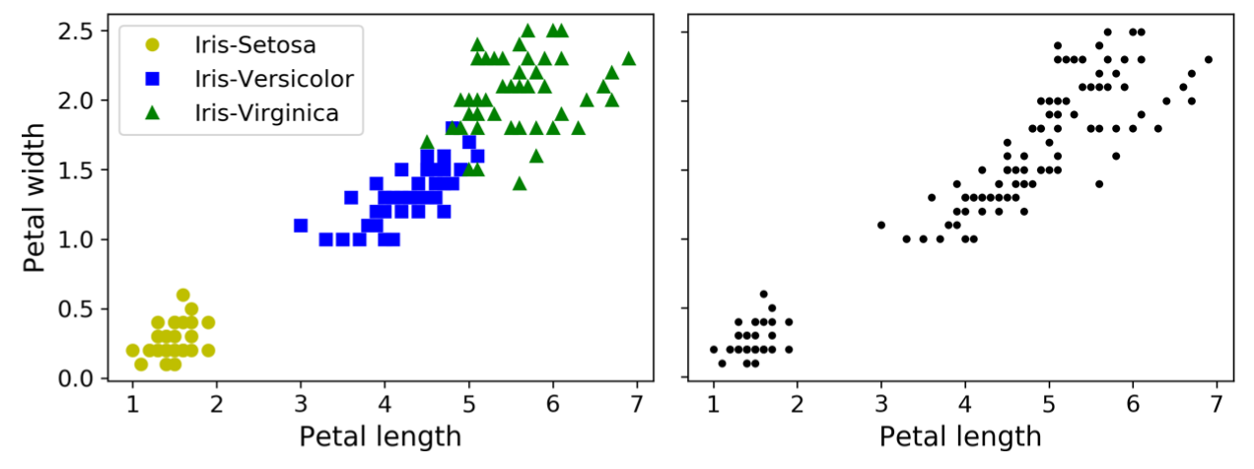
Classification versus Clustering

Slide 5
Clustering

Slide 6
Clustering
For customer segmentation: you can cluster your customers based on their purchases, their activity on your website, and so on. This is useful to understand who your customers are and what they need, so you can adapt your products and marketing campaigns to each segment. For example, this can be useful in recommender systems to suggest content that other users in the same cluster enjoyed.
For data analysis: when analysing a new dataset, it is often useful to first discover clusters of similar instances, as it is often easier to analyse clusters separately.
For anomaly detection (also called outlier detection): any instance that has a low affinity to all the clusters is likely to be an anomaly. For example, if you have clustered the users of your website based on their behaviour, you can detect users with unusual behaviour, such as an unusual number of requests per second, and so on. Anomaly detection is particularly useful in detecting defects in manufacturing, or for fraud detection.
For semi-supervised learning: if you only have a few labels, you could perform clustering and propagate the labels to all the instances in the same cluster. This can greatly increase the amount of labels available for a subsequent supervised learning algorithm, and thus improve its performance.
For search engines: for example, some search engines let you search for images that are similar to a reference image. To build such a system, you would first apply a clustering algorithm to all the images in your database: similar images would end up in the same cluster. Then when a user provides a reference image, all you need to do is to find this image’s cluster using the trained clustering model, and you can then simply return all the images from this cluster.
To segment an image: by clustering pixels according to their colour, then replacing each pixel’s colour with the mean colour of its cluster, it is possible to reduce the number of different colours in the image considerably. This technique is used in many object detection and tracking systems, as it makes it easier to detect the contour of each object.

Slide 7
Clustering
K-Means

Slide 8
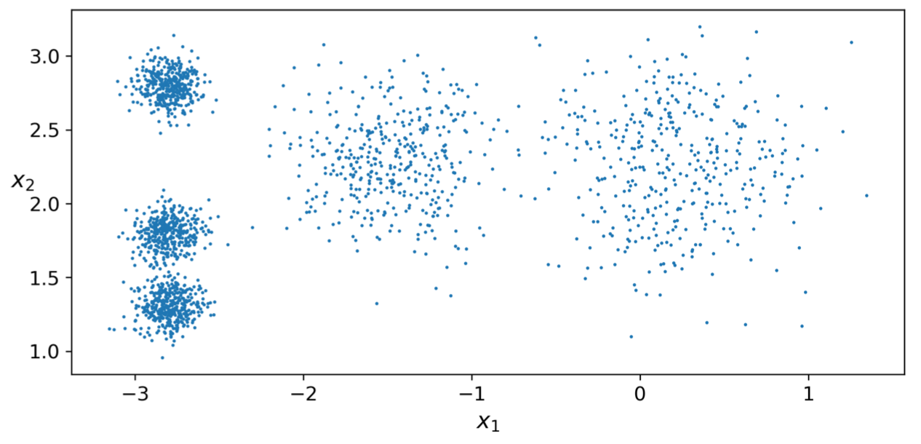
K-Means

Slide 9
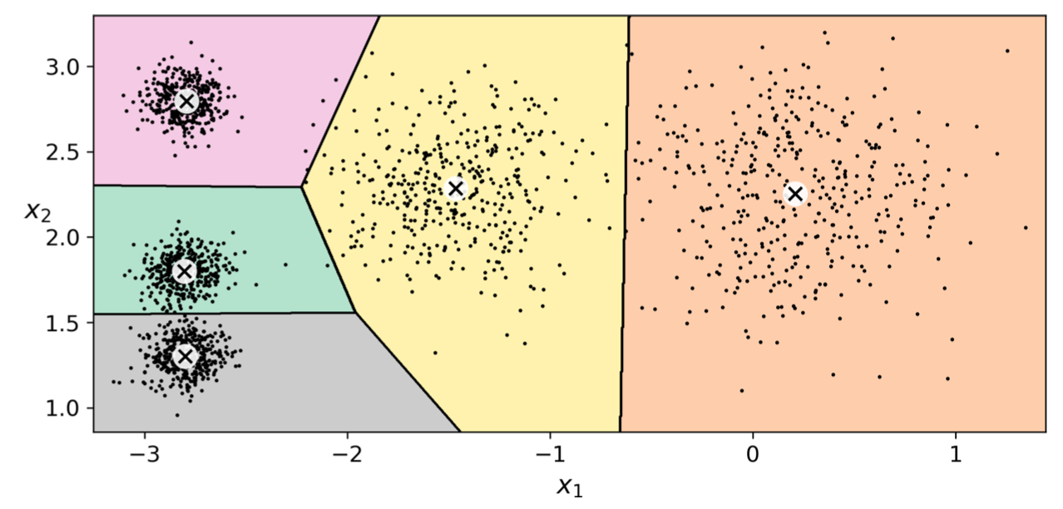
K-Means
from sklearn.cluster import KMeans
k=5
kmeans = KMeans(n_clusters=k)
y_pred = kmeans.fit_predict(X)
It will try to find each blob’s centre and assign each instance to the closest blob.
Note that you have to specify the number of clusters k that the algorithm must find.

Slide 10
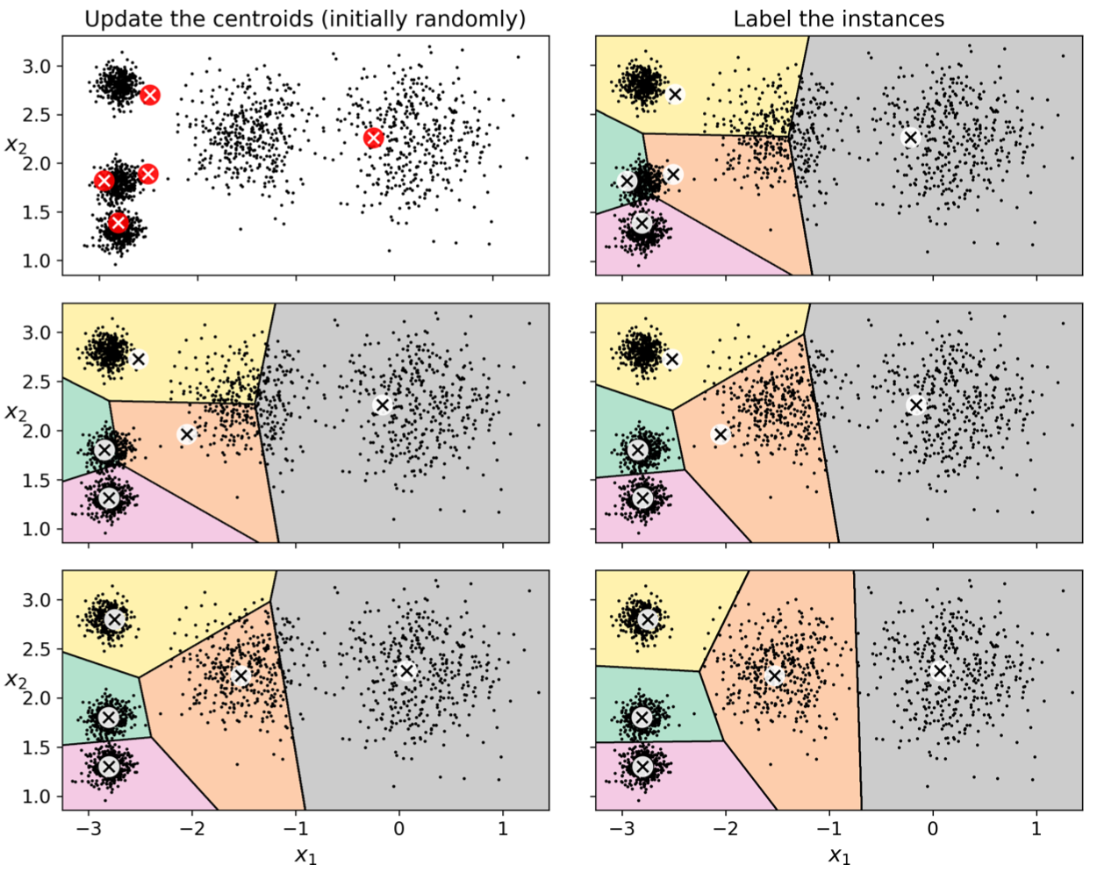
K-Means
It starts by placing the centroids randomly (e.g., by picking k instances at random and using their locations as centroids).
Then label the instances, update the centroids (calculate a new centroid based on all assigned instances), label the instances, update the centroids, and so on until the centroids stop moving.

Slide 11
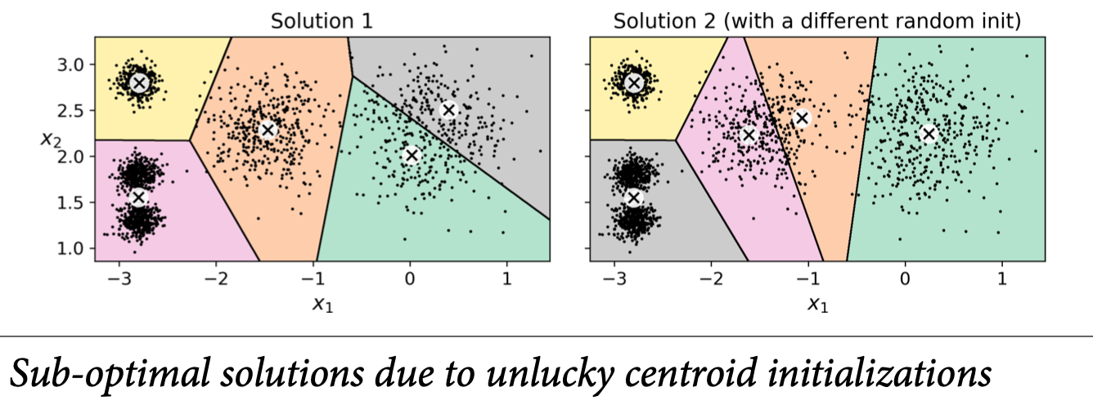
K-Means
Unfortunately, although the algorithm is guaranteed to converge, it may not converge to the right solution (i.e., it may converge to a local optimum): this depends on the centroid initialization.

Slide 12
Centroid Initialization Methods
If you happen to know approximately where the centroids should be, then you can set the init hyperparameter to a NumPy array containing the list of centroids, and set n_init to 1:
good_init = np.array([[-3, 3], [-3, 2], [-3, 1], [-1, 2], [0, 2]])
kmeans = KMeans(n_clusters=5, init=good_init, n_init=1)
Another solution is to run the algorithm multiple times with different random initializations and keep the best solution. This is controlled by the n_init hyperparameter: by default, it is equal to 10.
it uses a performance metric called the model’s inertia: this is the mean squared distance between each instance and its closest centroid.

Slide 13
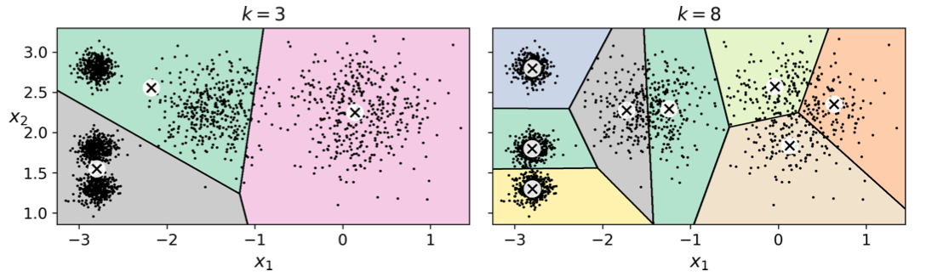
Finding the Optimal Number of Clusters
So far, we have set the number of clusters k to 5 because it was obvious by looking at the data that this is the correct number of clusters. But in general, it will not be so easy to know how to set k, and the result might be quite bad if you set it to the wrong value.

Slide 14
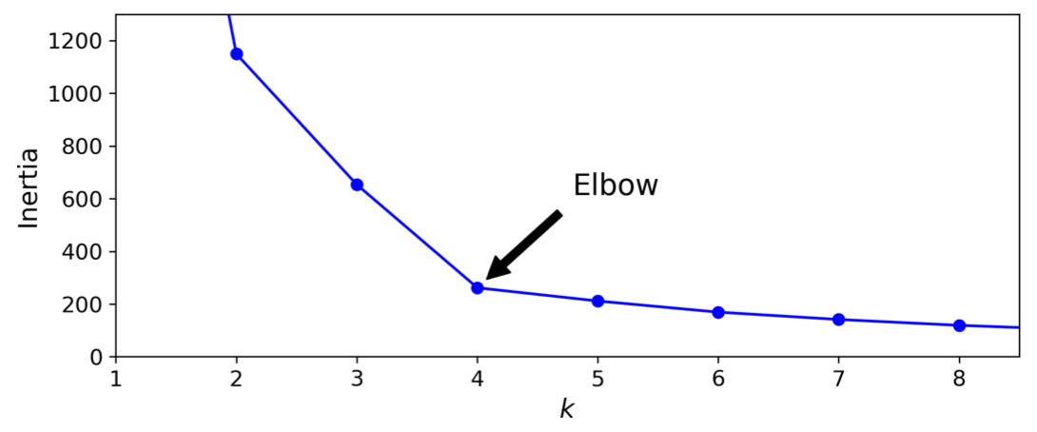
Finding the Optimal Number of Clusters
You might be thinking that we could just pick the model with the lowest inertia. Unfortunately, the inertia is not a good performance metric when trying to choose k since it keeps getting lower as we increase k. Indeed, the more clusters there are, the closer each instance will be to its closest centroid, and therefore the lower the inertia will be.
As you can see, the inertia drops very quickly as we increase k up to 4, but then it decreases much more slowly as we keep increasing k. This curve has roughly the shape of an arm, and there is an “elbow” at k=4 so if we did not know better, it would be a good choice: any lower value would be dramatic, while any higher value would not help much, and we might just be splitting perfectly good clusters in half for no good reason.

Slide 15
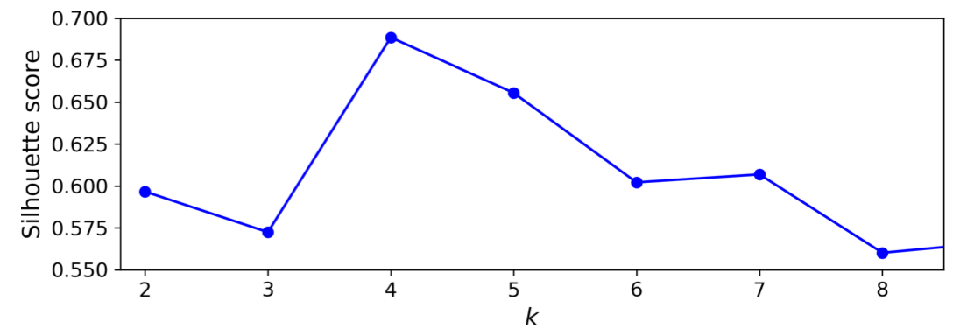
Finding the Optimal Number of Clusters
A more precise approach (but also more computationally expensive) is to use the silhouette score, which is the mean silhouette coefficient over all the instances.
An instance’s silhouette coefficient is equal to (b – a) / max(a, b) where a is the mean distance to the other instances in the same cluster (it is the mean intra-cluster distance), and b is the mean nearest-cluster distance, that is the mean distance to the instances of the next closest cluster (defined as the one that minimizes b, excluding the instance’s own cluster).
The silhouette coefficient can vary between -1 and +1: a coefficient close to +1 means that the instance is well inside its own cluster and far from other clusters, while a coefficient close to 0 means that it is close to a cluster boundary, and finally a coefficient close to -1 means that the instance may have been assigned to the wrong cluster.

Slide 16
Clustering
DBSCAN

Slide 17
DBSCAN - Density-based spatial clustering of applications with noise
This algorithm defines clusters as continuous regions of high density:
For each instance, the algorithm counts how many instances are located within a small distance ε (epsilon) from it. This region is called the instance’s ε- neighbourhood.
If an instance has at least min_samples instances in its ε-neighbourhood (including itself), then it is considered a core instance. Core instances are those that are located in dense regions.
All instances in the neighbourhood of a core instance belong to the same cluster. This may include other core instances, therefore a long sequence of neighbouring core instances forms a single cluster.
Any instance that is not a core instance and does not have one in its neighbourhood is considered an anomaly.
from sklearn.cluster import DBSCAN
from sklearn.datasets import make_moons
X, y = make_moons(n_samples=1000, noise=0.05)
dbscan = DBSCAN(eps=0.05, min_samples=5)
dbscan.fit(X)

Slide 18
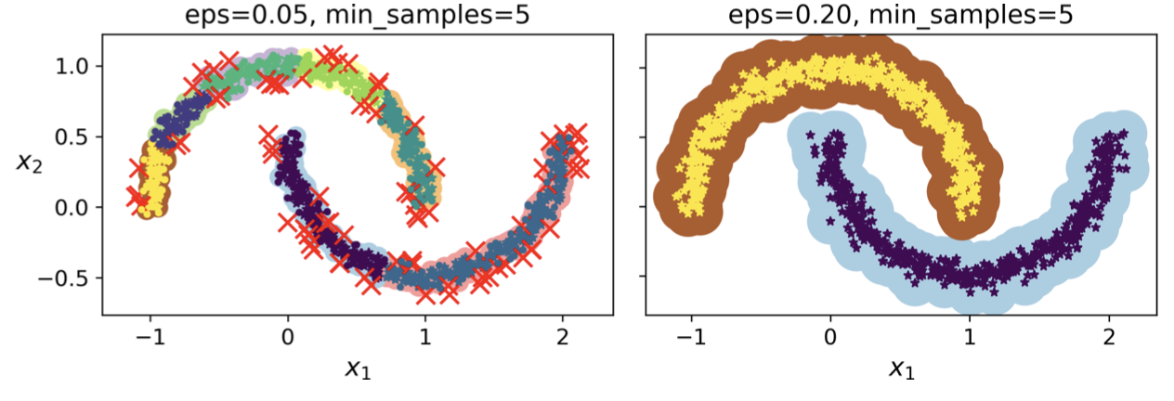
DBSCAN - Density-based spatial clustering of applications with noise
It identified quite a lot of anomalies, plus 7 different clusters. Fortunately, if we widen each instance’s neighbourhood by increasing eps to 0.2, we get the clustering on the right, which looks perfect.

Slide 19
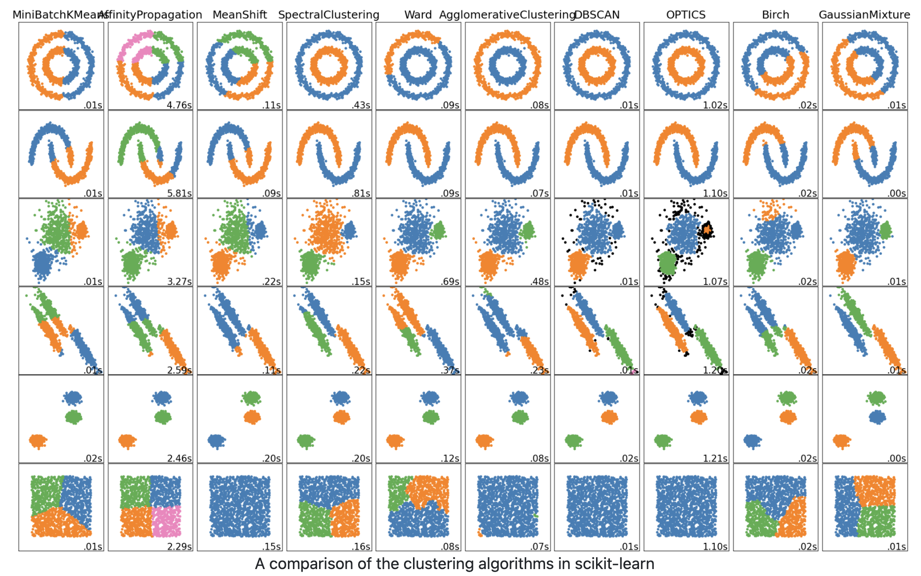
Other clustering methods
https://scikit-learn.org/stable/modules/clustering.html

Slide 20
Use cases of clustering

Slide 21
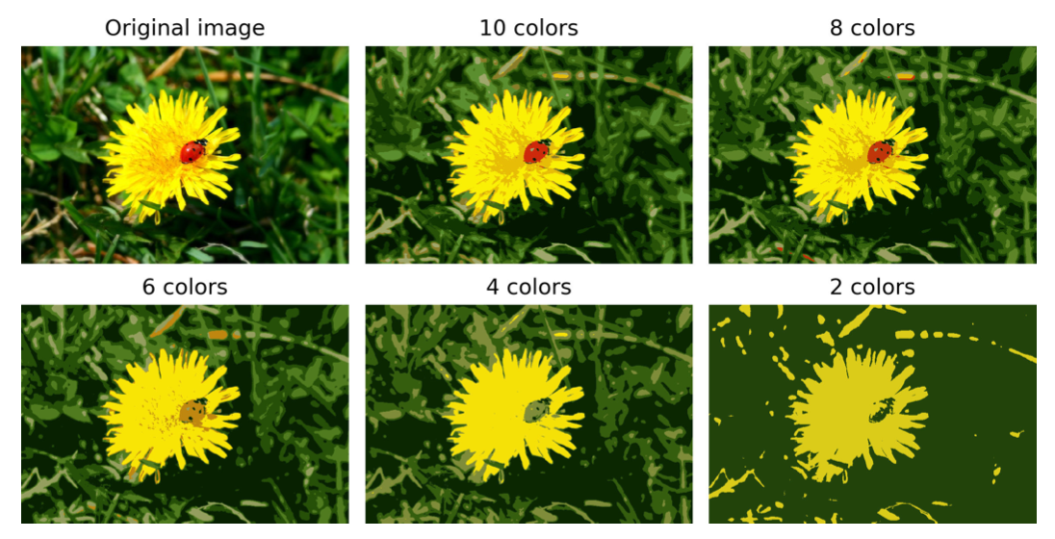
Using clustering for image segmentation
Image segmentation is the task of partitioning an image into multiple segments. In semantic segmentation, all pixels that are part of the same object type get assigned to the same segment.

Slide 22
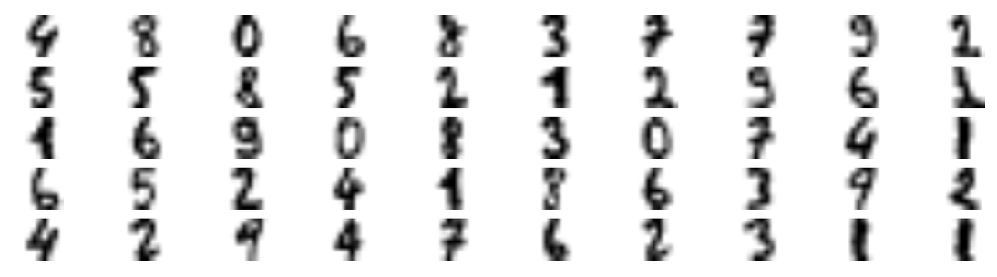
Using Clustering for Semi-Supervised Learning
Another use case for clustering is in semi-supervised learning, when we have plenty of unlabelled instances and very few labelled instances.
First, let’s cluster the training set into 50 clusters, then for each cluster let’s find the image closest to the centroid. We will call these images the representative images:
k=50
kmeans = KMeans(n_clusters=k)
X_digits_dist = kmeans.fit_transform(X_train)
representative_digit_idx = np.argmin(X_digits_dist, axis=0) X_representative_digits = X_train[representative_digit_idx]

Slide 23
Using Clustering for Semi-Supervised Learning
Now the 50 images are manually labelled and trained:
>>> log_reg = LogisticRegression()
>>> log_reg.fit(X_representative_digits, y_representative_digits) >>> log_reg.score(X_test, y_test)
0.9244444444444444
one step further: we can propagate the labels to all the other instances (or nearby instances) in the same cluster, then train a model. This is called label propagation:
>>> log_reg = LogisticRegression()
>>> log_reg.fit(X_train_partially_propagated, y_train_partially_propagated) >>> log_reg.score(X_test, y_test)
0.9422222222222222

Slide 24
Active Learning
To continue improving your model and your training set, the next step could be to do a few rounds of active learning: this is when a human expert interacts with the learning algorithm, providing labels when the algorithm needs them.
There are many different strategies for active learning, but one of the most common ones is called uncertainty sampling:
The model is trained on the labelled instances gathered so far, and this model is used to make predictions on all the unlabelled instances.
The instances for which the model is most uncertain (i.e., when its estimated probability is lowest) must be labelled by the expert.
Then you just iterate this process again and again, until the performance improvement stops being worth the labelling effort.
Other strategies include labelling the instances that would result in the largest model change, or the largest drop in the model’s validation error, or the instances that different models disagree on (e.g., an SVM, a Random Forest, and so on).

Slide 25
Gaussian Mixtures
https://jakevdp.github.io/PythonDataScienceHandbook/05.12-gaussian-mixtures.html

Slide 26
Gaussian Mixtures
A Gaussian mixture model (GMM) is a probabilistic model that assumes that the instances were generated from a mixture of several Gaussian distributions whose parameters are unknown.
All the instances generated from a single Gaussian distribution form a cluster that typically looks like an ellipsoid. Each cluster can have a different ellipsoidal shape, size, density and orientation.
When you observe an instance, you know it was generated from one of the Gaussian distributions, but you are not told which one, and you do not know what the parameters of these distributions are.

Slide 27
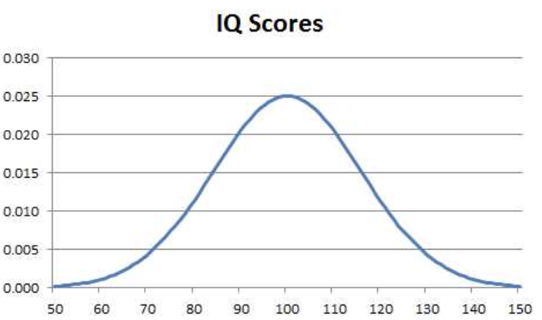
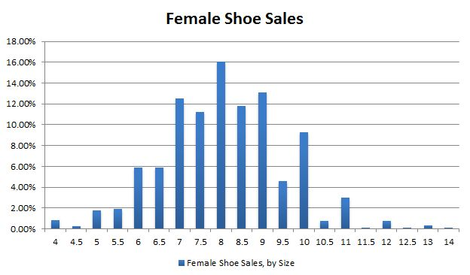
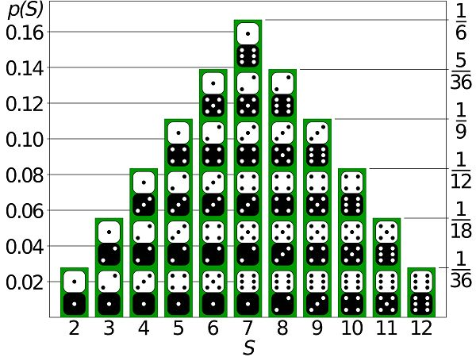
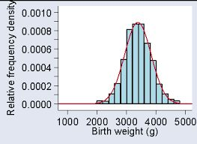
Gaussian distribution

Slide 28
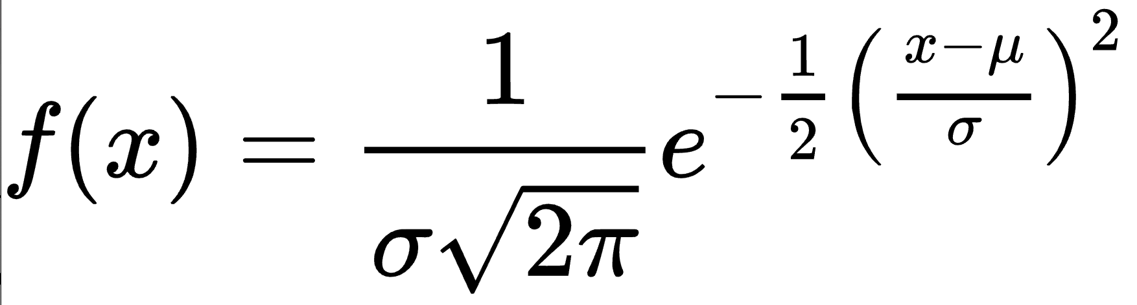

Gaussian distribution
In probability theory, a normal (Gaussian) distribution is a type of continuous probability distribution for a real-valued random variable. The general form is:
For the normal distribution, the values less than one standard deviation away from the mean account for 68.27% of the set; while two standard deviations from the mean account for 95.45%; and three standard deviations account for 99.73%.

Slide 29
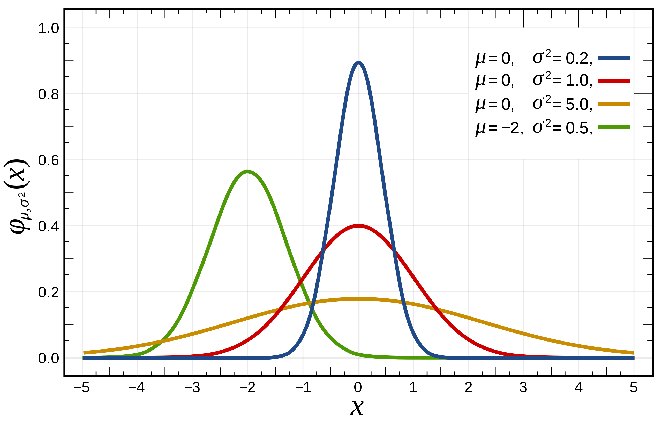
Gaussian distribution

Slide 30
Gaussian Mixtures
A Gaussian mixture model (GMM) is a probabilistic model that assumes that the instances were generated from a mixture of several Gaussian distributions whose parameters are unknown.

Slide 31
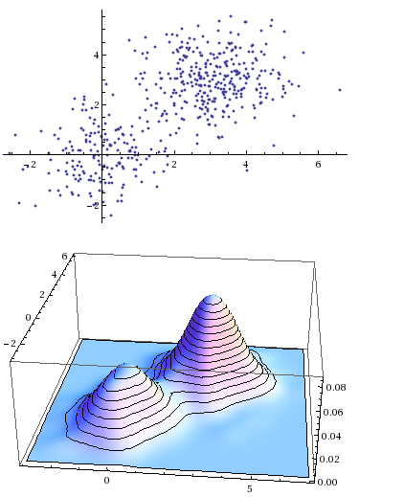
Gaussian Mixtures
All the instances generated from a single Gaussian distribution form a cluster that typically looks like an ellipsoid. Each cluster can have a different ellipsoidal shape, size, density and orientation.
When you observe an instance, you know it was generated from one of the Gaussian distributions, but you are not told which one, and you do not know what the parameters of these distributions are.

Slide 32
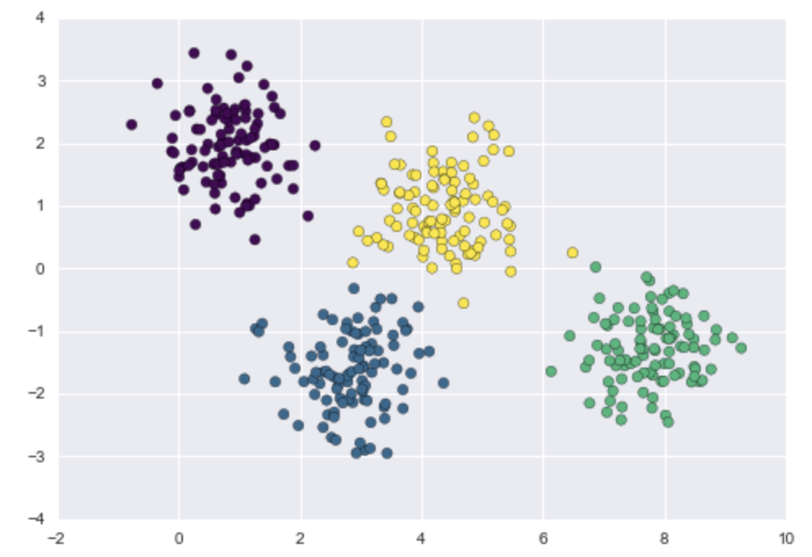
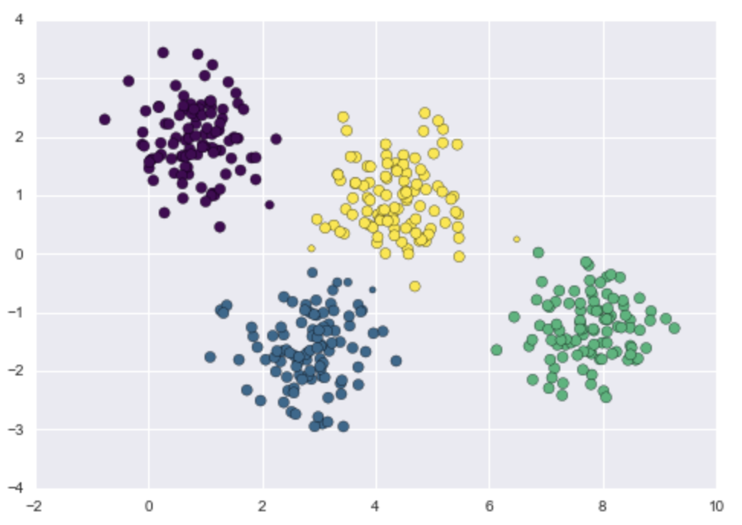
Gaussian Mixtures
https://jakevdp.github.io/PythonDataScienceHandbook/05.12-gaussian-mixtures.html
probs = gmm.predict_proba(X)
print(probs[:5].round(3))
size = 50 * probs.max(1) ** 2 # square emphasizes differences
plt.scatter(X[:, 0], X[:, 1], c=labels, cmap='viridis', s=size);
from sklearn.mixture import GMM gmm = GMM(n_components=4).fit(X) labels = gmm.predict(X) plt.scatter(X[:, 0], X[:, 1], c=labels, s=40, cmap='viridis');
Notes:
https://jakevdp.github.io/PythonDataScienceHandbook/05.12-gaussian-mixtures.html

Slide 33
Gaussian Mixtures
Under the hood, a Gaussian mixture model is very similar to k-means: it uses an expectation–maximization approach which qualitatively does the following:
Choose starting guesses for the location and shape
Repeat until converged:
E-step: for each point, find weights encoding the probability of membership in each cluster
M-step: for each cluster, update its location, normalization, and shape based on all data points, making use of the weights

Slide 34
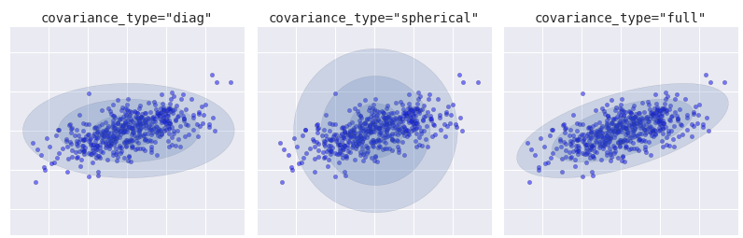
Choosing the covariance type
The covariance_type hyperparameter controls the degrees of freedom in the shape of each cluster; it is essential to set this carefully for any given problem. The default is covariance_type="diag", which means that the size of the cluster along each dimension can be set independently, with the resulting ellipse constrained to align with the axes. A slightly simpler and faster model is covariance_type="spherical", which constrains the shape of the cluster such that all dimensions are equal. A more complicated and computationally expensive model is to use "full", which allows each cluster to be modelled as an ellipse with arbitrary orientation.

Slide 35
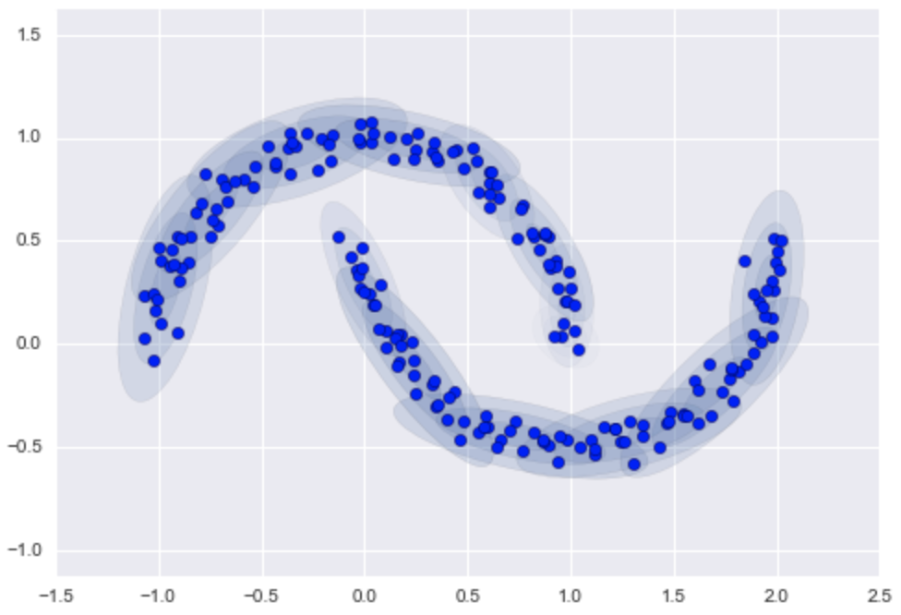
GMM as Density Estimation
Here the mixture of 16 Gaussians serves not to find separated clusters of data, but rather to model the overall distribution of the input data. This is a generative model of the distribution, meaning that the GMM gives us the recipe to generate new random data distributed similarly to our input.
from sklearn.datasets import make_moons
Xmoon, ymoon = make_moons(200, noise=.05, random_state=0)
#plt.scatter(Xmoon[:, 0], Xmoon[:, 1]);
gmm16 = GMM(n_components=16, covariance_type='full', random_state=0) plot_gmm(gmm16, Xmoon, label=False)

Slide 36
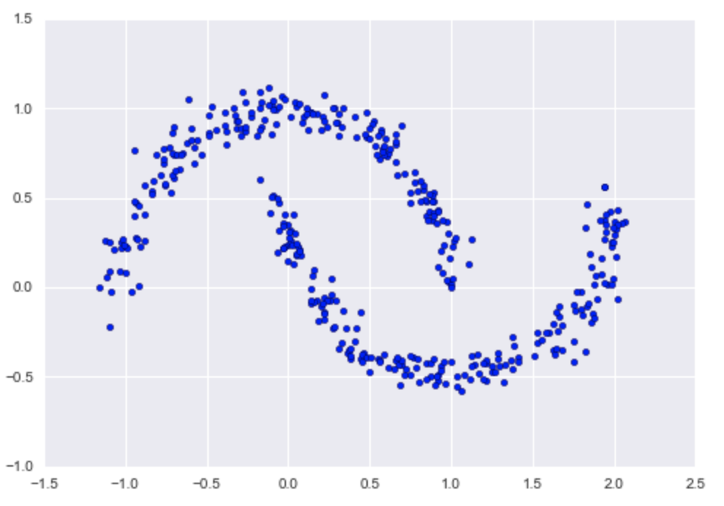
GMM as Density Estimation
Here are 400 new points drawn from this 16-component GMM fit to our original data:
Xnew = gmm16.sample(400, random_state=42) plt.scatter(Xnew[:, 0], Xnew[:, 1]);

Slide 37
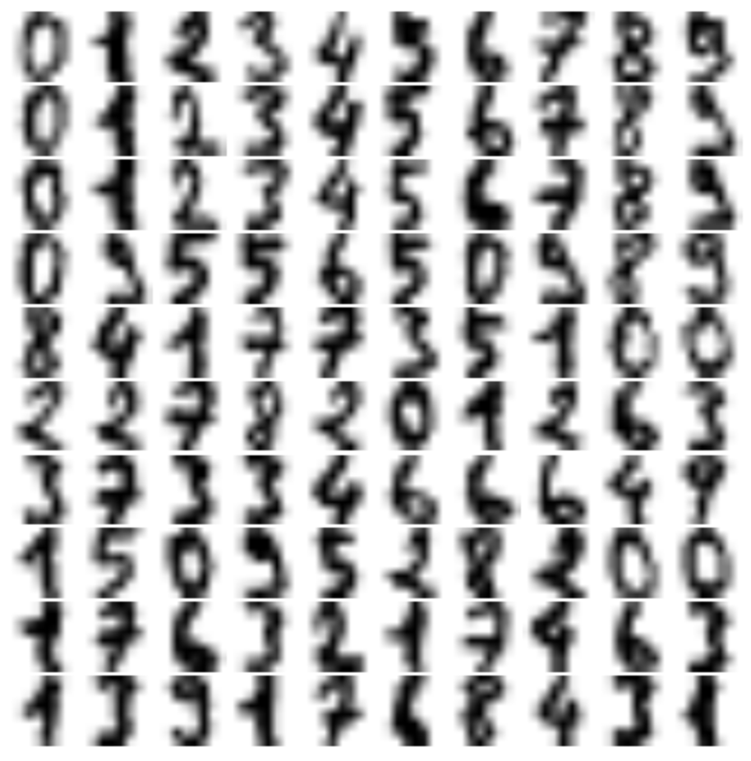
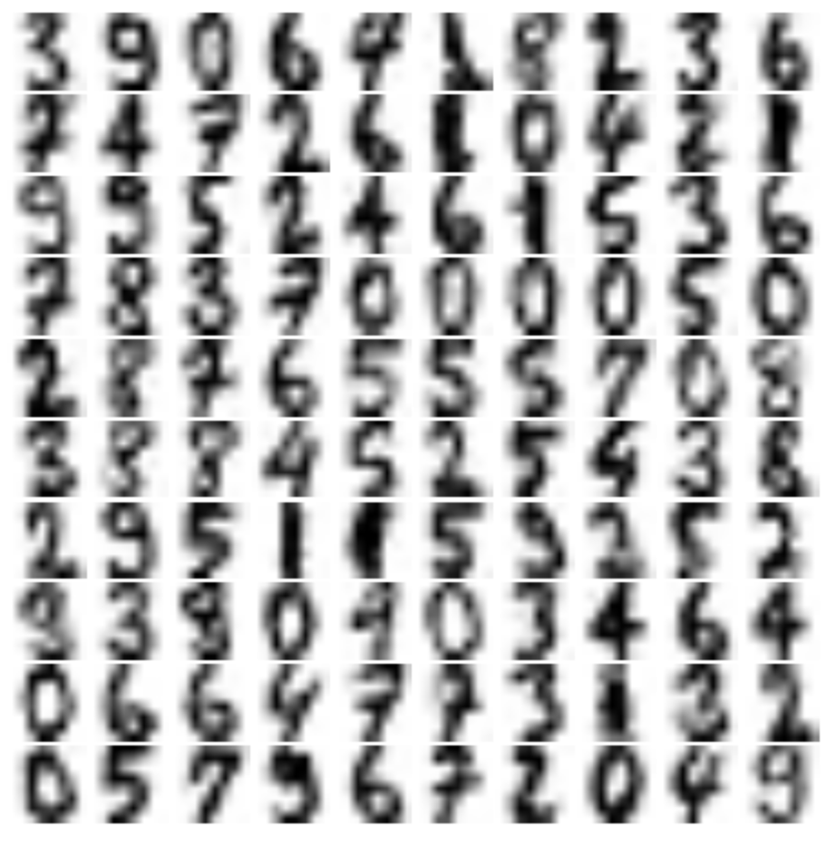
GMM as Density Estimation
Given a sampling of handwritten digits, we can model the distribution of that data in such a way that we can generate brand new samples of digits from the data:

